Slide 1
How a computer reads your tic-tac-toe move
CONVOLUTIONAL NEURAL NETWORKS
One picture, four operations, twenty numbers. We build the whole network by hand and check every figure.
WORKED EXAMPLE AFTER
EVERY NUMBER HERE
Josh Starmer, StatQuest: Convolutional Neural Networks, Clearly Explained
was computed, not illustrated. All of it reproduces in ten lines of NumPy.
Notes:
Open by drawing a tic-tac-toe grid on the board and asking the class how they would write a program to tell an X from an O. Let them try for a minute. Somebody will propose checking specific pixels, which is exactly the approach that fails two slides from now.

Slide 2
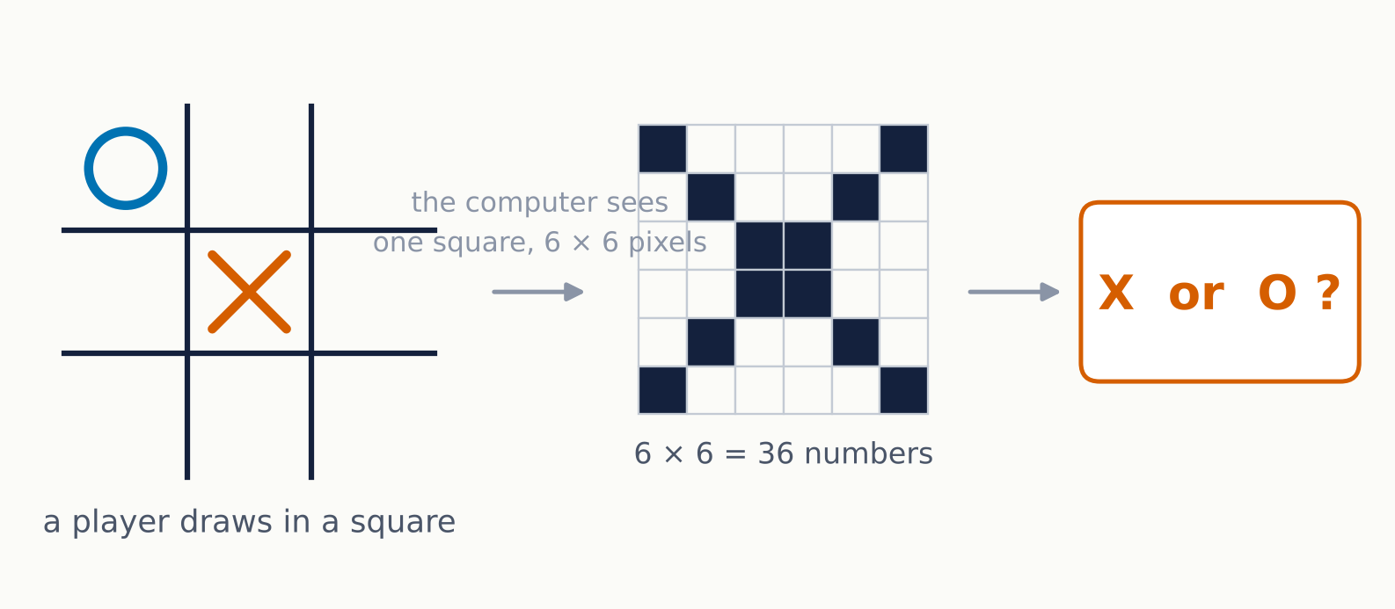
Someone draws in a square. Which letter is it?
THE TASK
We keep the picture deliberately tiny — six pixels square, black or white — so every number in this deck fits on a slide and you can check the arithmetic yourself.
Notes:
Emphasise that the smallness is the only simplification. Every operation on the following slides is exactly what runs on a 224 by 224 photograph; there is just more of it. Ask: how many different ways can a person draw an X in this box? Hundreds. That is the whole difficulty.

Slide 3
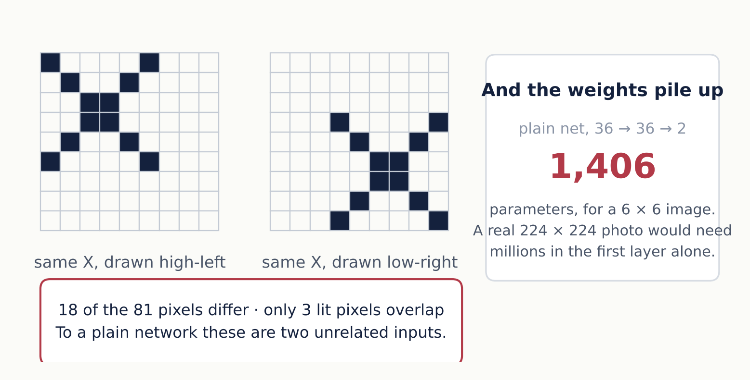
Every weight is tied to one fixed pixel
WHY NOT THE NETWORK WE ALREADY HAVE
Notes:
This is the slide that motivates everything else. The point is not that a dense network cannot learn this — with enough examples of X in every position it could. The point is that it has to learn each position separately, because weight number 7 only ever sees pixel number 7. Nothing it learns about an X in the corner transfers to an X in the middle. That is a terrible use of data.

Slide 4
Stop asking what is at pixel 14. Start asking whether a small pattern appears anywhere.
THE IDEA
01
02
03
Look locally
Reuse the detector
Blur the location
A stroke is a relationship between neighbouring pixels, not between pixel 3 and pixel 30.
One set of weights, applied at every position. What you learn in one corner works in all of them.
Record that the pattern was found near here, not at exactly this coordinate.
Notes:
These three ideas are the whole architecture. Everything on the remaining slides is one of them made concrete. If students remember nothing else, this is the slide to remember.

Slide 5
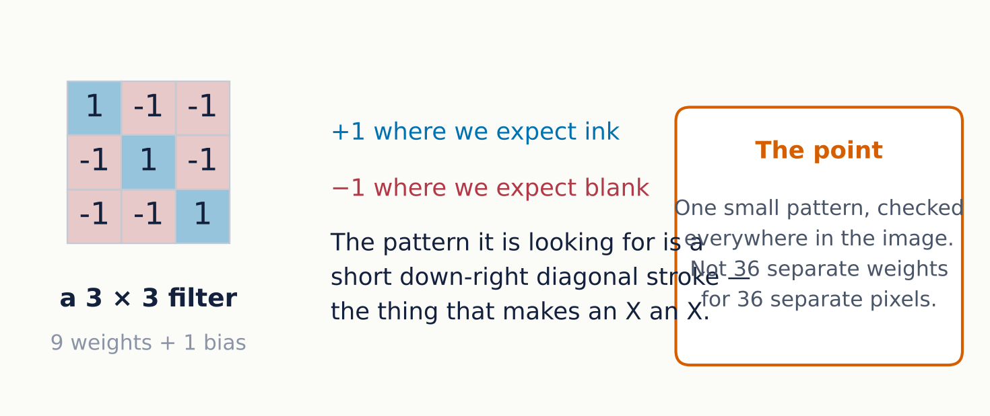
A filter is a small picture of what to look for
OPERATION 1 OF 4 · CONVOLUTION
Here the nine weights were chosen by hand so the mechanism is visible. In a real network nobody chooses them — they are learned by gradient descent, exactly like any other weight.
Notes:
Worth stressing the last sentence twice. Students often come away thinking engineers design filters. They did until about 2012; now the filter is just a parameter block and backpropagation finds it. Hand-designing it here is purely so the arithmetic is interpretable.

Slide 6
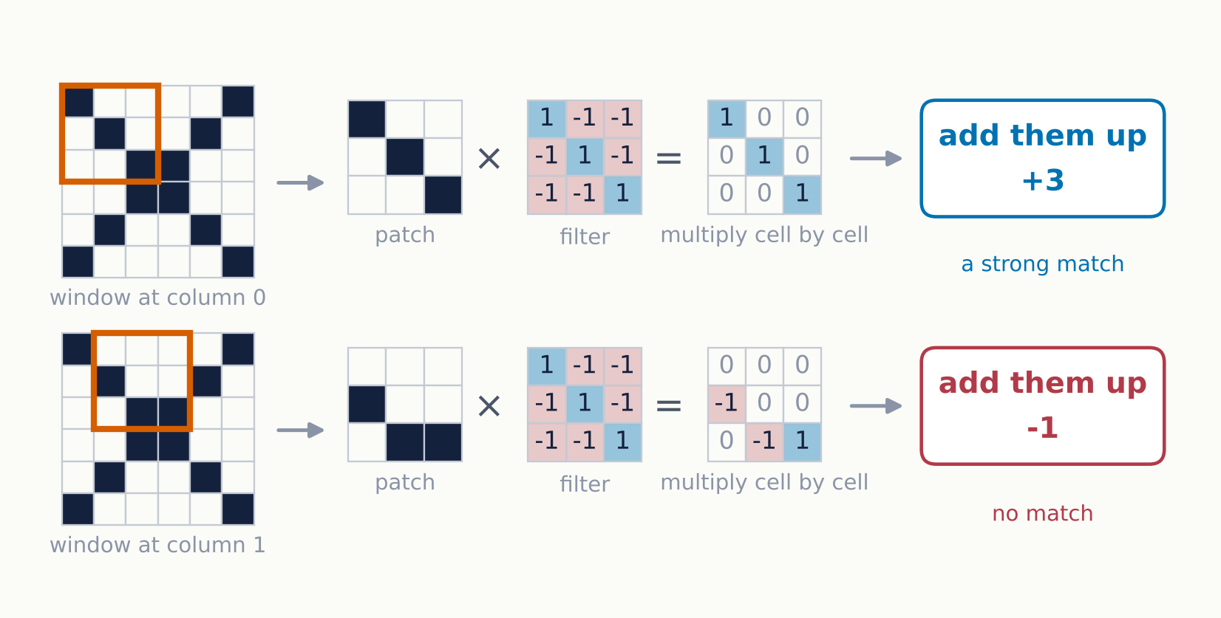
Lay it over a patch, multiply, add up
OPERATION 1 OF 4 · CONVOLUTION
Nine multiplications and an addition, repeated at every position. A high score means the patch looks like the filter; a negative score means it looks like the opposite.
Notes:
Walk the top row out loud, cell by cell: one times one is one, zero times minus one is zero, and so on to plus three. Then do the bottom row fast. Students need to see it once slowly and once quickly before it becomes automatic. Note that this is a dot product between two 9-vectors, which is the same operation as a single neuron in the dense network they already know.

Slide 7
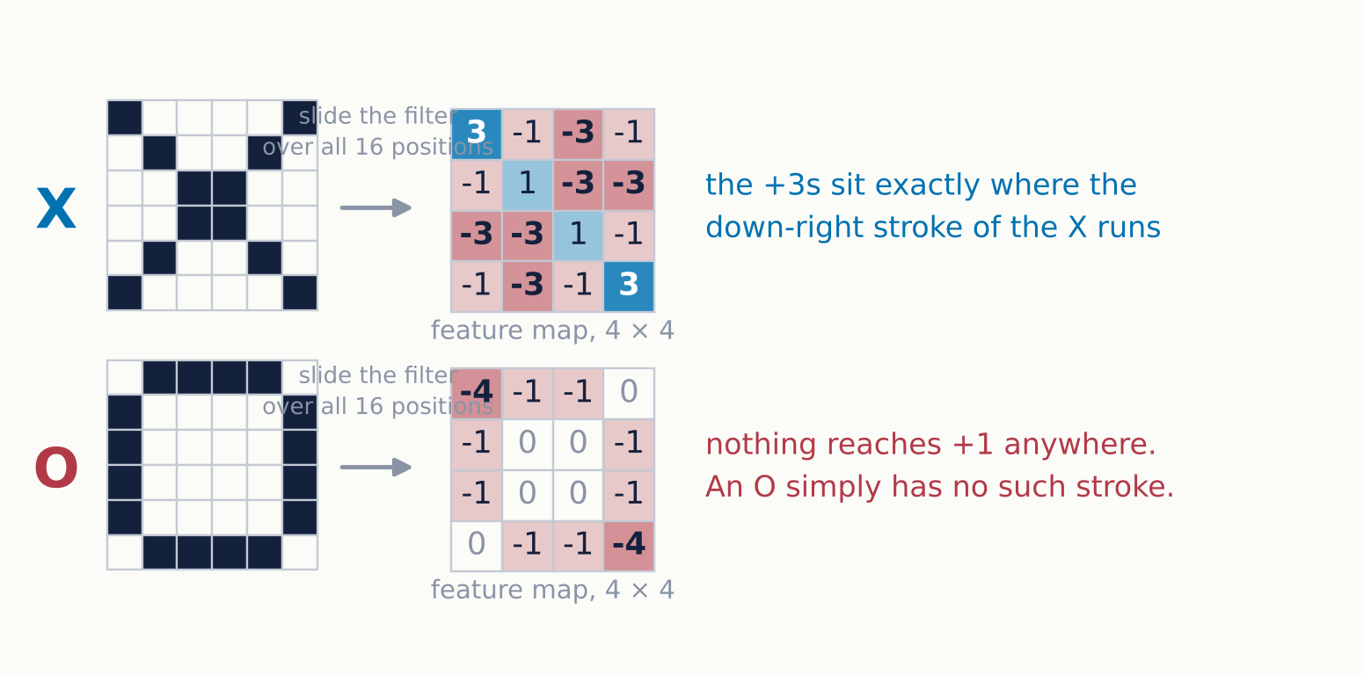
Sixteen positions, sixteen scores
OPERATION 1 OF 4 · CONVOLUTION
The feature map is not a picture of the X. It is a map of where this particular stroke was found — and for the O, a map of having found nothing.
Notes:
Ask why the X map has two strong +3s rather than one. Because the X contains two separate down-right segments, top-left and bottom-right, and the filter finds both. The 6 by 6 image becomes 4 by 4 because a 3 by 3 window only has 4 valid positions along each axis. If that bothers anyone, padding is the fix, mentioned later.

Slide 8
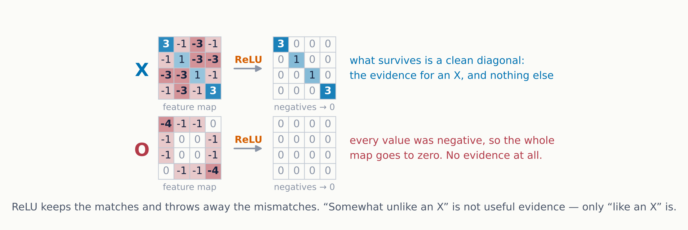
Keep the evidence, discard its absence
OPERATION 2 OF 4 · RELU
ReLU is one line: anything below zero becomes zero. It is also the only non-linearity here, and without it the whole network would collapse into a single linear map.
Notes:
Two things to draw out. First, interpretation: a negative convolution score means "this patch is the photographic negative of what I am looking for", which is not evidence for anything useful, so discarding it is sensible rather than arbitrary. Second, the mathematical necessity: convolution is linear and the final layer is linear, so stacking them without ReLU gives one linear function no matter how many layers you add. This is the same argument they saw for dense networks.

Slide 9
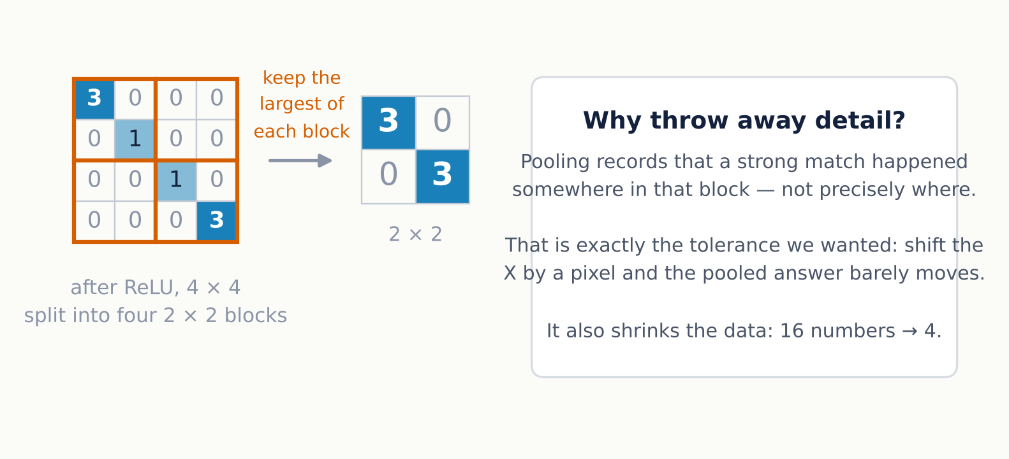
Somewhere in this corner, not at this pixel
OPERATION 3 OF 4 · MAX POOLING
Deliberately losing information is the point, not a side effect. Precise position is exactly the thing we want the network to stop caring about.
Notes:
Counter-intuitive enough to be worth a pause. Everywhere else in their training, throwing away data is bad. Here it is the mechanism that buys translation tolerance. The trade-off is real though: pool too aggressively and the network can no longer tell a face from a scrambled face, which is Hinton's long-standing complaint about pooling and the motivation behind capsule networks.

Slide 10
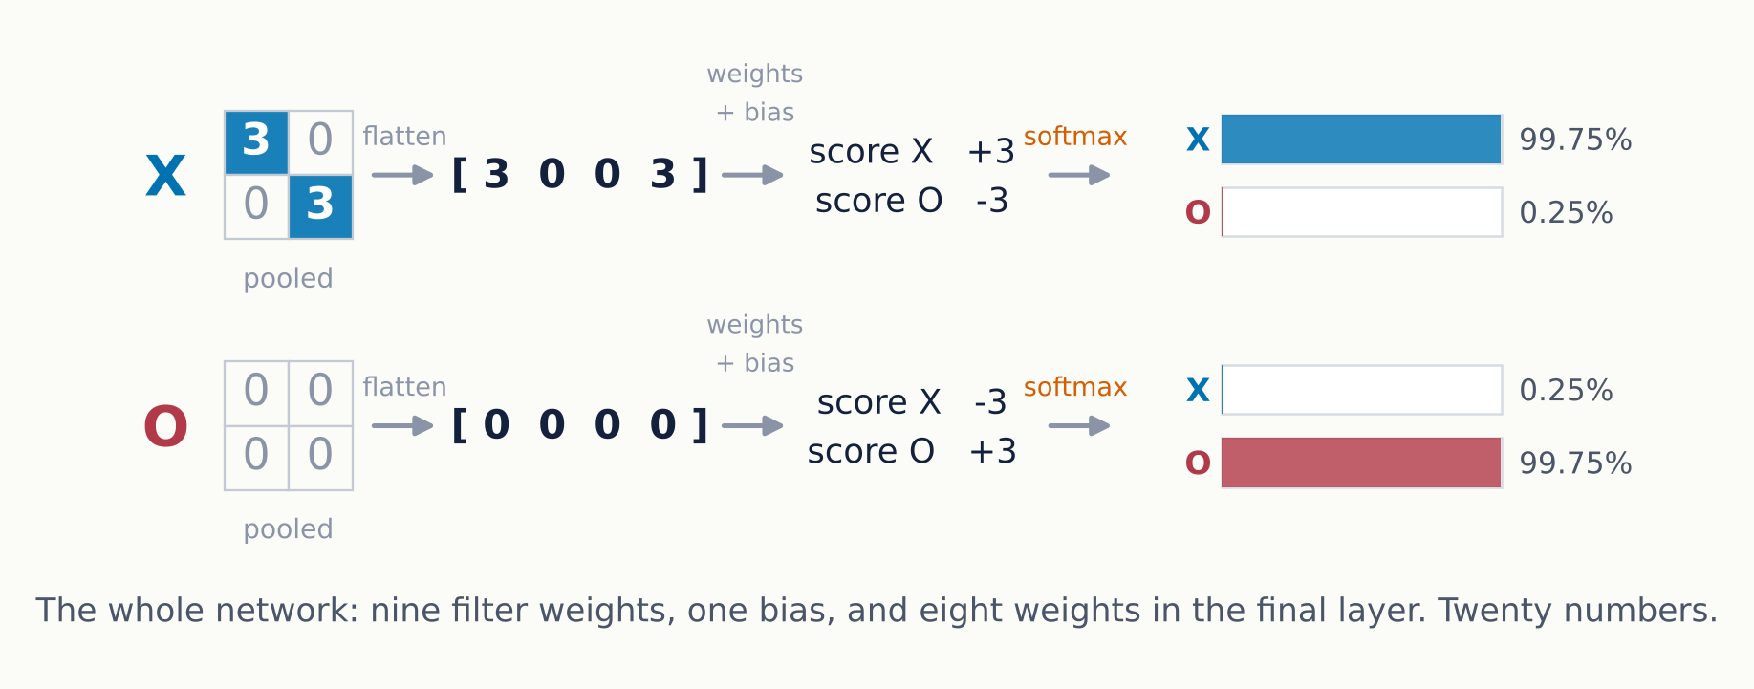
Flatten, weigh, turn scores into probabilities
OPERATION 4 OF 4 · THE CLASSIFIER
The last step is the ordinary dense layer they already know, fed with four numbers instead of thirty-six — and those four mean something.
Notes:
This is where the two halves of the course join up. Everything before this slide is feature extraction; this slide is the classifier from the MNIST notebook, unchanged. Make the point that the convolutional part has not classified anything — it has turned raw pixels into a short, meaningful description, which is a far easier thing to classify.

Slide 11
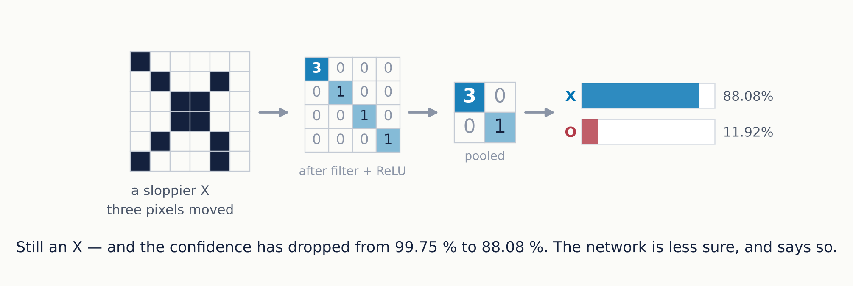
An X nobody would be proud of
THE TEST THAT ACTUALLY MATTERS
Right answer, lower confidence. The network degrades gracefully instead of failing — and it tells you it is less sure, which is the part you can act on.
Notes:
Tie this back to the applicability-domain discussion from the Gaussian process material. A number with no sense of its own reliability is of limited use in engineering. Here the drop from 99.75 to 88.08 is the model saying it saw less of the pattern it was trained to find. Note also that this is a plain softmax probability, which is a far cruder uncertainty estimate than a GP's; it is better than nothing, not good.

Slide 12
Three assumptions, each buying something
WHY IT WORKS
Local windows
Shared weights
Pooling
A filter only ever sees nine neighbouring pixels at once.
The same nine numbers are reused at all sixteen positions.
Only the strongest response in each block survives.
Buys: far fewer weights, and an assumption that is true of images — meaning lives in neighbourhoods.
Buys: every training example teaches the filter sixteen times over, wherever the stroke fell.
Buys: tolerance to small shifts, and a smaller representation to hand on.
In the language of the rest of this course: an architecture is a prior. A CNN is the statement that your data has local structure which repeats, and that position matters only approximately. Images satisfy that. Spectra and time series often do. A table of process variables does not.
Notes:
The final paragraph is the transferable lesson. Encourage them to ask of any architecture: what is it assuming about my data, and is that assumption true? For a 1D CNN on a spectrum or a sensor trace the answer is often yes. For twenty tabular process variables in arbitrary column order it is clearly no, and a tree ensemble will win.

Slide 13
Seventy times fewer parameters, same task
THE BILL
Fully connected, 36 → 36 → 2
Convolutional, 1 filter → pool → 2
1,406
20
and none of them transfer between positions
9 filter weights, 1 bias, 8 in the output layer, 2 output biases
The gap widens enormously with image size. A 3 × 3 filter costs ten parameters whether the image is 6 pixels across or 6,000; a fully-connected first layer costs more every time you add a row.
Counts verified in PyTorch, not estimated.
Notes:
If someone asks about real numbers: AlexNet in 2012 had about 60 million parameters, and roughly 90 percent of them sat in its three fully-connected layers rather than its five convolutional ones. Modern architectures such as ResNet dropped most of those dense layers and got both smaller and better.

Slide 14
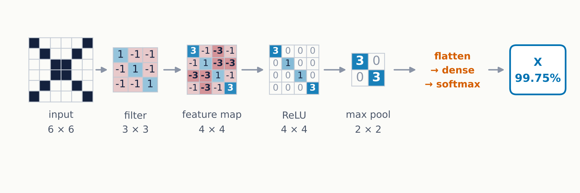
Thirty-six pixels in, one letter out
ALL OF IT AT ONCE
Convolution finds the pattern, ReLU keeps only the hits, pooling forgets exactly where, and an ordinary dense layer makes the call. Every value above was computed; none was chosen to look convincing.
Notes:
Good slide to leave up during questions. If you have time, run the NumPy version live and perturb the input — move a pixel, flip one, erase a corner — and watch the probability move. Twenty lines of code and it responds sensibly, which is more persuasive than any slide.

Slide 15
What changes in a network you would use
SCALING UP
In our toy | In a real CNN | Why
One filter | 32 to 512 per layer | One pattern is not enough — you want edges at every orientation, corners, textures
One convolution | Tens of layers, stacked | Early layers find edges; later ones combine them into shapes, then objects
Filter chosen by hand | Filter learned by backpropagation | Nobody designs filters any more. They are weights like any other
One channel | Three, for red, green and blue | Each filter becomes 3 × 3 × 3 and sums across the colours
No padding, stride 1 | Padding to hold the size, stride 2 to halve it | Control over how fast the map shrinks as depth grows
The four operations do not change. There is simply more of each.
Notes:
The most important row is the third. Students who have only met hand-built image processing assume a human still picks the kernels, as in Sobel or Gaussian filters. Make clear that the convolution kernel is initialised randomly and found by gradient descent, exactly like the dense weights they already trained in the MNIST notebook.

Slide 16
Five lines you have already seen
THE SAME NETWORK IN CODE
Conv2d(1, 1, 3) — one input channel, one filter, 3 × 3. Ten parameters.
model = nn.Sequential(
nn.Conv2d(1, 1, kernel_size=3),
ReLU — negatives to zero.
nn.ReLU(),
nn.MaxPool2d(2),
MaxPool2d(2) — largest of each 2 × 2 block. 4 × 4 becomes 2 × 2.
nn.Flatten(),
nn.Linear(4, 2),
Flatten — the 2 × 2 becomes a vector of four.
)
Linear(4, 2) — the classifier. Ten more parameters.
Input (N, 1, 6, 6) → output (N, 2). Twenty parameters, confirmed.
Notes:
Run this live if you can. sum(p.numel() for p in model.parameters()) returns 20, which closes the loop with the parameter slide. Note that no softmax appears here for the same reason as in the MNIST notebook: nn.CrossEntropyLoss applies it internally, so the model emits raw logits.

Slide 17
Four honest limitations
WHAT IT DOES NOT GIVE YOU
Shift yes, rotate no
Still data hungry
Pooling forgets layout
Softmax is no error bar
Pooling buys tolerance to translation only. Turn the X forty-five degrees and our diagonal filter stops firing. Rotation and scale must be taught by augmenting the data.
Cheaper than a dense net, not cheap. Real CNNs want thousands of labelled images per class, a serious obstacle for most laboratory datasets.
Pool hard enough and a network records that it found two eyes and a mouth without checking they were arranged like a face.
88 percent sounds like a probability but is not calibrated. Shown something unlike anything in training, a CNN will still answer, often confidently.
Where this matters for us: in-line inspection and microscopy are good fits because images are plentiful. Predicting a property from twenty process variables is not an image problem, and a CNN is the wrong prior for it.
Notes:
The fourth card connects straight back to the Gaussian process work. A GP widens its error bars outside its training region; a CNN does not. If a prediction has to carry a safety or quality decision, that difference is the whole argument.

Slide 18
What to remember
FIVE THINGS TO TAKE AWAY
01
02
03
04
05
A convolution is a dot product between a small filter and a patch, repeated everywhere.
Sharing one filter across the image is what makes a CNN cheap, and what makes it generalise.
ReLU keeps the matches. Pooling deliberately forgets where they were.
The convolutional part does not classify. It writes a short description that a dense layer can.
An architecture is an assumption about your data. Check it before reaching for the model.
TO WATCH
TO TRY
Josh Starmer, StatQuest: Convolutional Neural Networks, Clearly Explained — the source of this worked example
Rebuild this in twenty lines of NumPy, then move one pixel at a time and watch the probability fall.
Notes:
End on takeaway five. It is the one that transfers beyond images, and it is the question worth asking of every model in the rest of the course.

